Slide 1
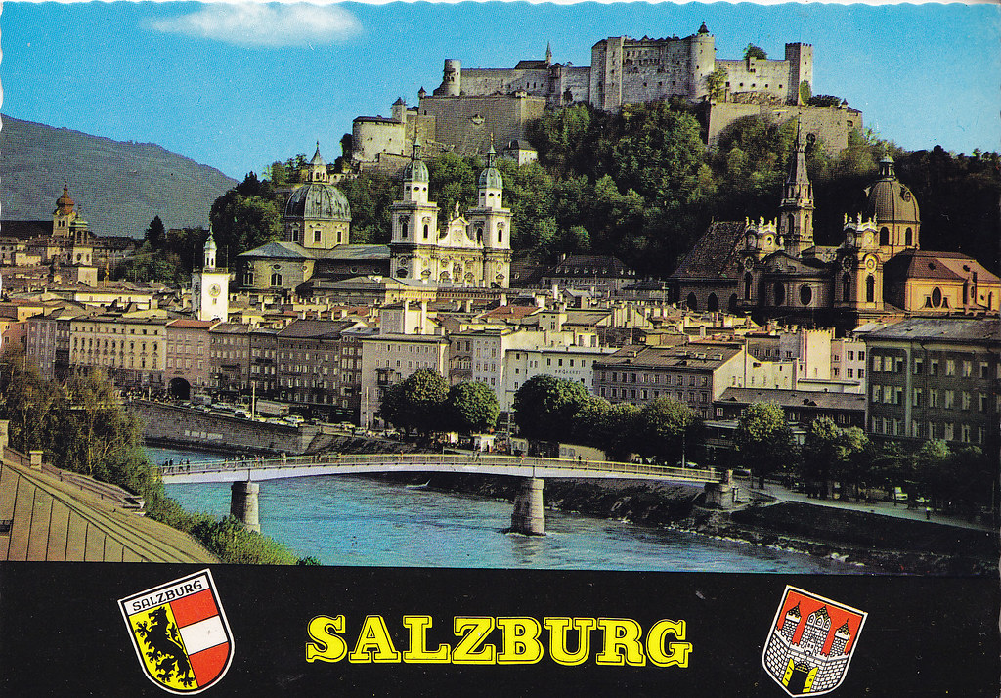
SALZBURG: MUZEJ RED BULL HANGAR – STADION RED BULL SALZBURG – ŽIVALSKI VRT – DVOREC HELLBRUNN
sobota, 31. 5. 2025

Slide 2
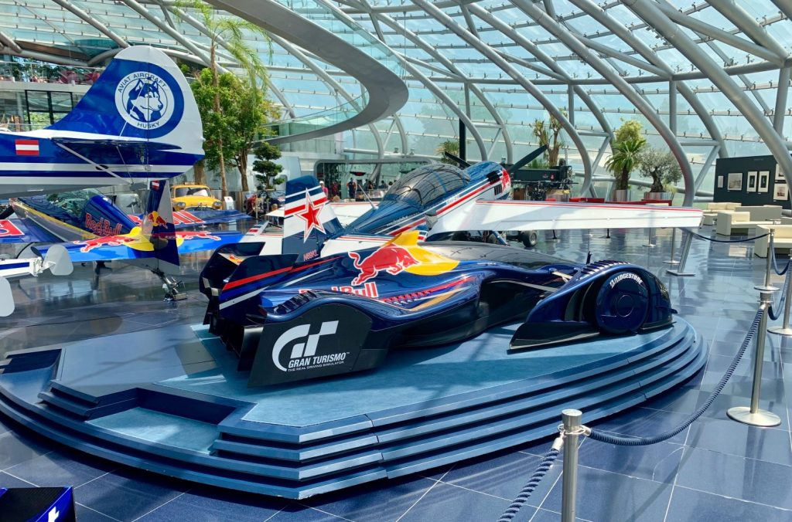
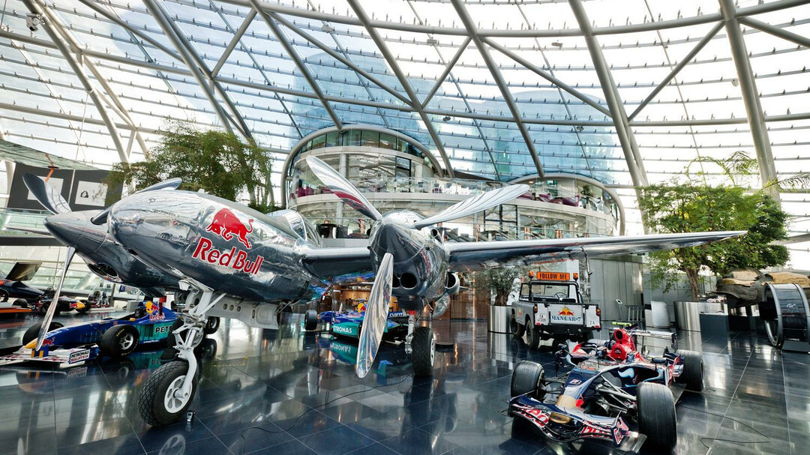
RED BULL HANGAR -7
https://www.salzburg.info/en/sights/museums/hangar-7
https://www.redbull.com/si-sl/galleries/hangar-7-informacije

Slide 3
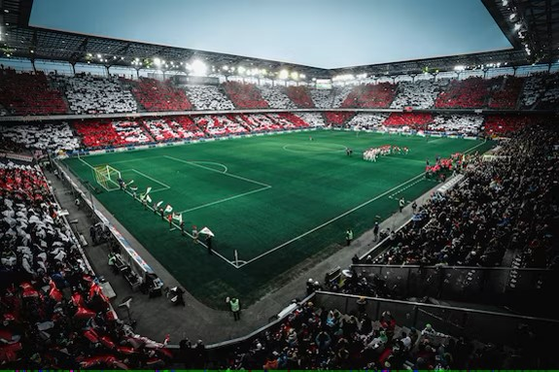
https://www.redbullsalzburg.at/en/red-bull-arena
FC RED BULL ARENA

Slide 4

ŽIVALSKI VRT SALZBURG
https://salzburg-zoo.at/

Slide 5
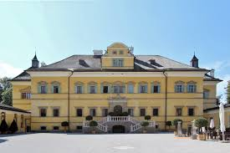
DVOREC HELLBRUNN
https://www.hellbrunn.at/

